Slide 1

HTML / CSS / Git Fundamentals
Week 1 Day 1 - June 6, 2022 - Doug Case
Notes:
Michael

Slide 2

HTML / CSS / Git Fundamentals
Week 1 Day 1 Goals
Connect HTML and CSS files together
Describe responsive design and accessibility
Get comfortable with add / commit / push workflow for Git
Git fundamentals - and self-study info - ask TA’s / etc if need help

Slide 3
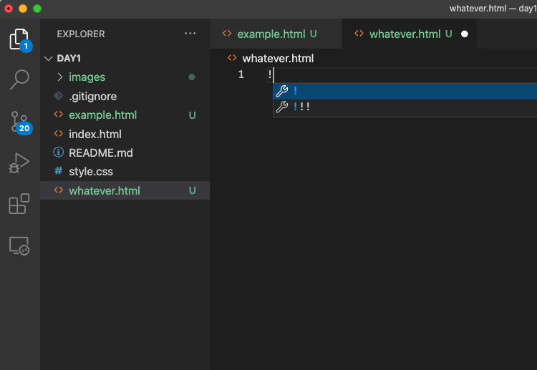
Visual Studio shortcut for html files
Add ! and then hit tab

Slide 4
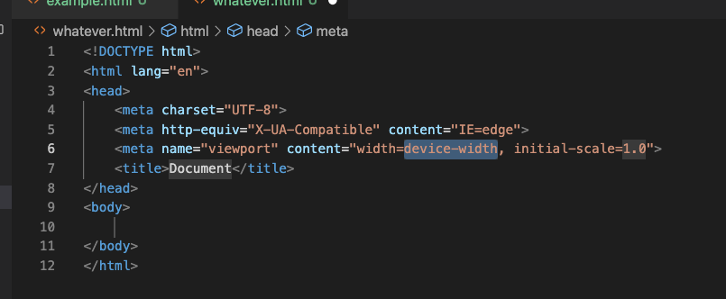
Visual Studio shortcut for html files
And this results

Slide 5
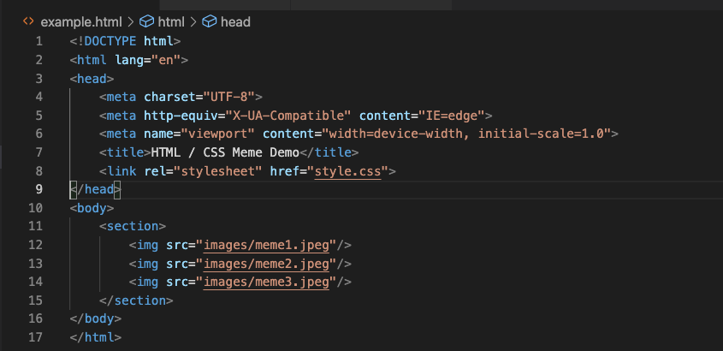
Change title, add link to CSS, add body:
And this results

Slide 6
Chrome debugger is effectively the standard
Chrome: View -> Developer -> Developer Tools
Elements tab is great for seeing layout, playing with CSS
Can use VS Code Live Server extension to launch code from .html
Or double-click on .html file to launch (but won’t work later for API calls)

Slide 7
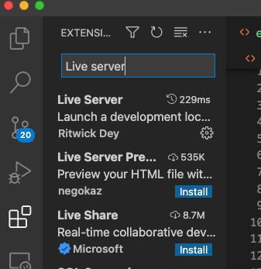
Config Visual Studio with Live Server Extension
In Visual Studio click on extensions icon
Then type in “Live Server”, then install
Click on Go Live icon at bottom of VS
Then when save changes in html file it automatically deploys to your default browser - suggest using Chrome

Slide 8
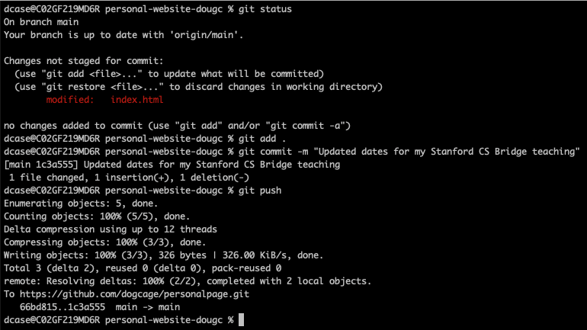
Useful Git commands
git status
git remote -v
git branch
git add <fn>
git add .
git commit -m “blah”
git push
git push - u origin main

Slide 9
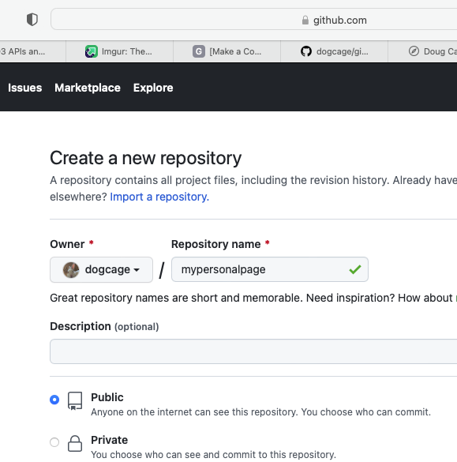
Create git repo
Go to github.com
Create new repo —---->
Go inside my new directory and:
git remote add origin https://github.com/dogcage/mypersonalpage.git
git add .
git commit -m “blah”
git branch -M main
git push -u origin main

Slide 10
Happy Coding (after break)!

